Slide 1


Sri Lanka Institute of Information Technology
Educational tool for age 10-12 children to enhance language skills and comprehension
Group - 24-25J-103

Slide 2



Sri Lanka Institute of Information Technology
SUPERVISOR PANNEL
Ms. Jenny
Ms.Dinuka
Supervisor
Co-Supervisor

Slide 3

MAIN COMPONENTS
01
Adaptive gamification system with realtime emotional feedback
02
Personalized Academic Content and Future Predictive Analytics
03
AI-based Interactive Voice Assessment
04
AI - Student Assistent

Slide 4

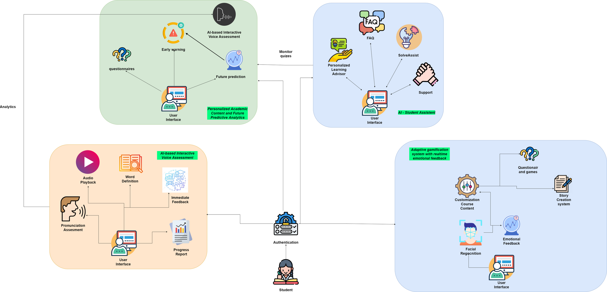
Sri Lanka Institute of Information Technology
OVERALL SYSTEM DIAGRAME

Slide 5

Sri Lanka Institute of Information Technology
ADAPTIVE GAMIFICATION SYSTEM WITH REALTIME EMOTIONAL FEEDBACK
24-25J-103
8/8/2024
IT21357794 Sirisena B G K D

Slide 6

Sri Lanka Institute of Information Technology
BACKGROUND
The adaptive gamification system integrates real-time emotional feedback to enhance language skills and comprehension for children aged 10-12. Utilizing AI-based facial recognition, the system detects emotions to dynamically adjust content. Features include interactive story creation, emotion-driven content adaptation, personalized progress reports, and emotional vocabulary expansion, ensuring an engaging and personalized learning experience.
24-25J-103
8/8/2024
IT21357794 Sirisena B G K D
24-25J-103

Slide 7


Sri Lanka Institute of Information Technology
REASEARCH GAP
Study | Real-time Emotional Feedback | Dynamic Story Creation | Emotion-Driven Content Adaptation | Personalized Progress Reports | Emotional Vocabulary Expansion | Parent and Educator Dashboard
Learning Express
EduVenture
EmotionEd
Proposed System
24-25J-103
8/8/2024
IT21357794 Sirisena B G K D

Slide 8

Sri Lanka Institute of Information Technology
How can an adaptive gamification system with real-time emotional feedback enhance language skills and comprehension for children aged 10-12?
RESEARCH PROBLEMS
What specific features of gamification can be integrated to effectively engage children in learning activities?
How can the system be designed to accommodate diverse emotional and learning needs of children within this age group?
What are the measurable improvements in language skills and comprehension as a result of using this adaptive gamification system?
24-25J-103
8/8/2024
IT21357794 Sirisena B G K D

Slide 9
Sri Lanka Institute of Information Technology
SPECIFIC OBJECTIVE
To develop an interactive story creation system that adapts to children's choices and encourages creative thinking and writing practice.
24-25J-103
8/8/2024
IT21357794 Sirisena B G K D

Slide 10
Sri Lanka Institute of Information Technology
SUB OBJECTIVES
01
Implement real-time emotional feedback using facial recognition technology to gauge emotions such as joy, confusion, or frustration.
02
Dynamically adjust story content or introduce mini-games based on the child's emotional state.
03
Generate personalized progress reports detailing reading and writing progress and emotional engagement.
04
Develop a parent and educator dashboard to provide insights into the child's progress and engagement levels.
24-25J-103
8/8/2024
IT21357794 Sirisena B G K D

Slide 11





Sri Lanka Institute of Information Technology
METHODOLOGY
TECHNOLOGIES
Natural Language Processing (NLP): SpaCy
Facial Recognition Technology: Microsoft Azure Face API
AI-Based Emotional Detection: TensorFlow
Game Design Principles: Unity
Data Visualization Tools: Chart.js
24-25J-103
8/8/2024
IT21357794 Sirisena B G K D

Slide 12
Sri Lanka Institute of Information Technology
SYSTEM, PERSONAL, AND SOFTWARE REQUIREMENT SPECIFICATION
Software Requirement
Personal Requirement
Functional Requirement
Non-Functional Requirement
Visual Studio Code
Python
MERN
Git
Azure
School teacher
School children
Parents of children
Child phsychologist
User Authentication
Data Collection
Time Tracking
Content Personalization
Real-time Feedback
Performance
Reliability and Availability
The system must be able to handle a large number of requests
24-25J-103
8/8/2024
IT21357794 Sirisena B G K D

Slide 13
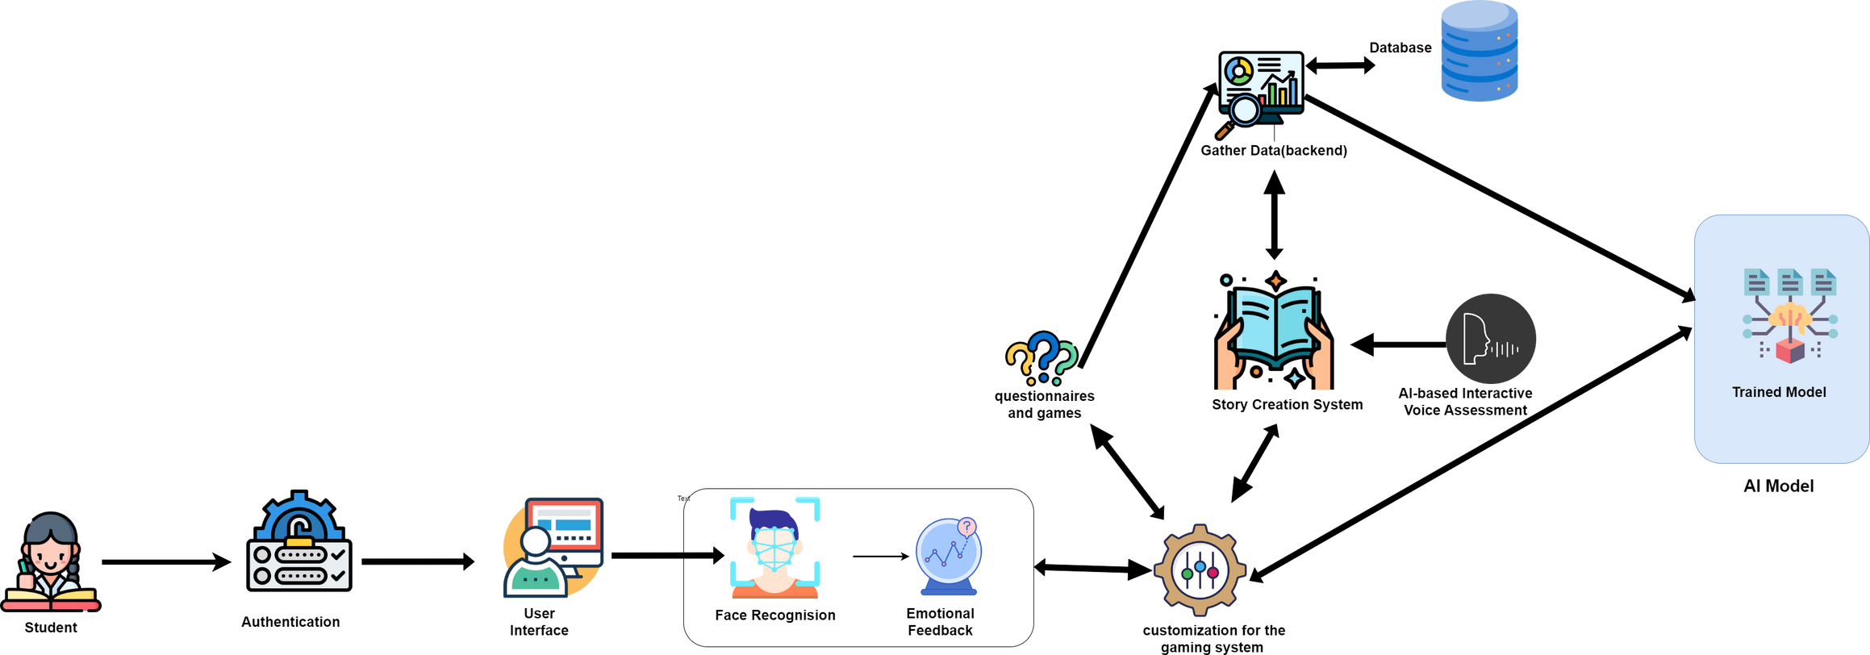
Sri Lanka Institute of Information Technology
System Diagram
24-25J-103
8/8/2024
IT21357794 Sirisena B G K D

Slide 14
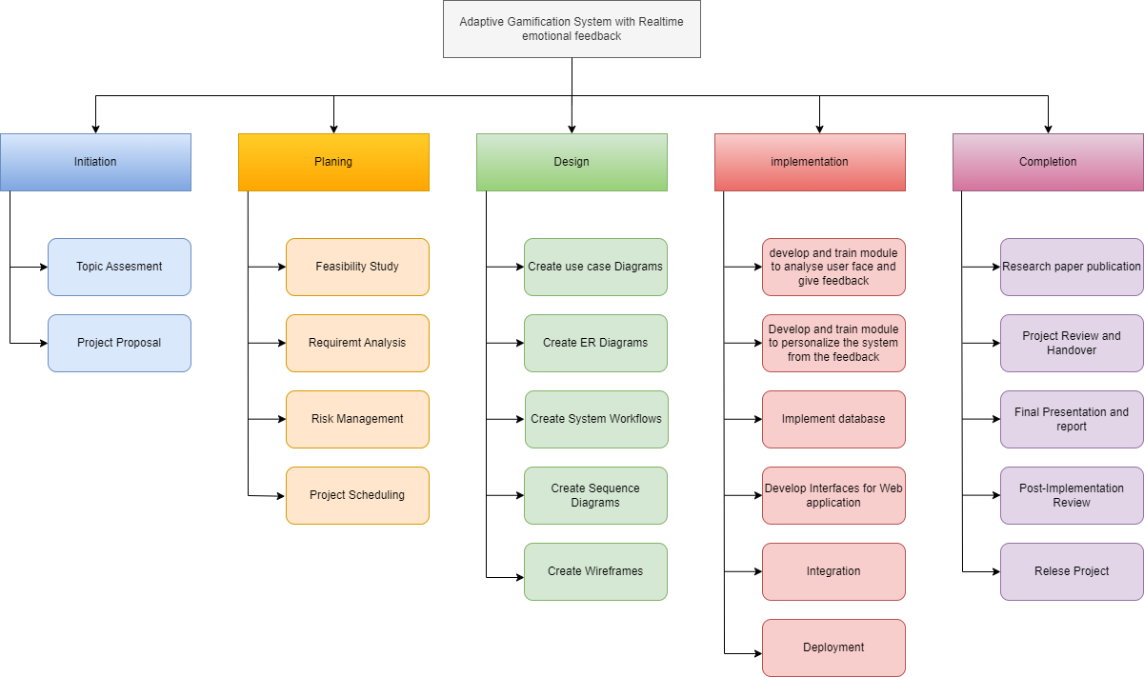
Sri Lanka Institute of Information Technology
WORK BREAKDOWN STRUCTURE
24-25J-103
8/8/2024
IT21357794 Sirisena B G K D

Slide 15

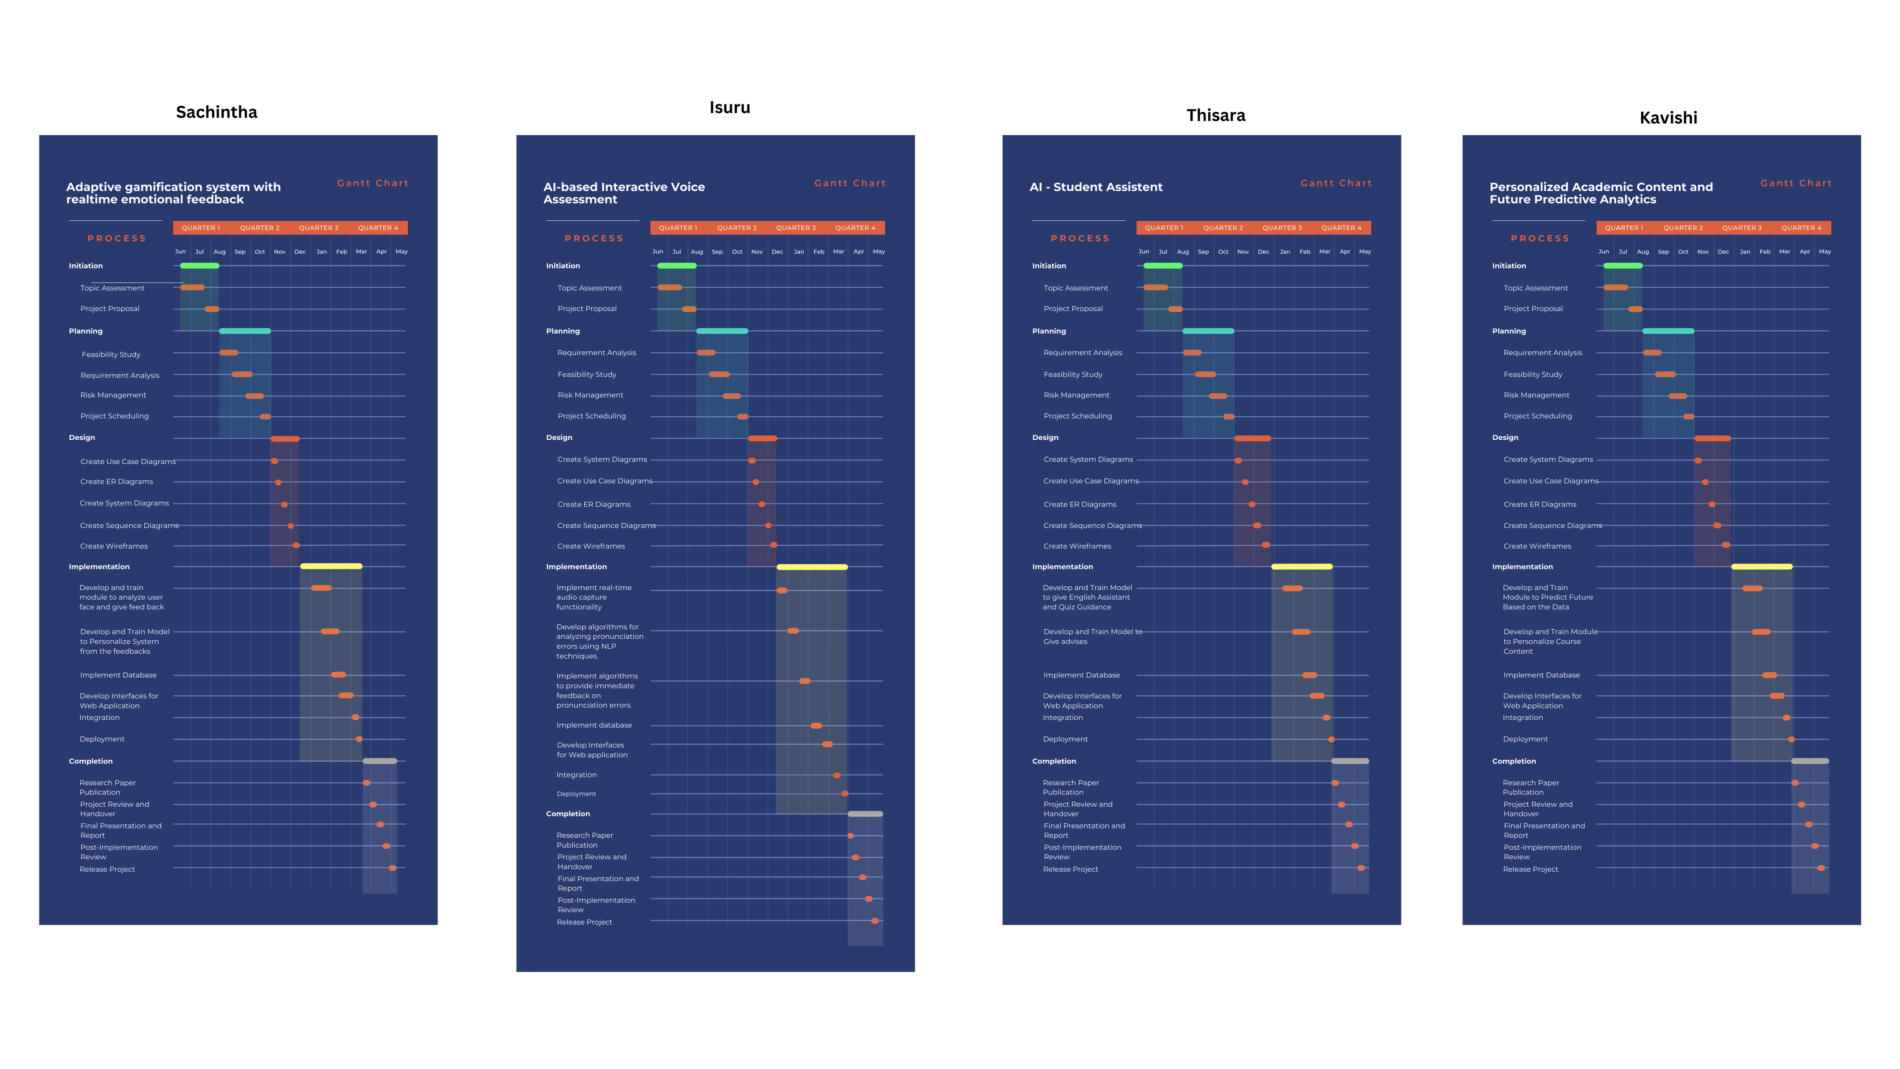

Sri Lanka Institute of Information Technology
GANNT CHART
24-25J-103
8/8/2024
IT21357794 Sirisena B G K D

Slide 16
Sri Lanka Institute of Information Technology
D'Mello, S. K., & Kory, J. (2015). A review and meta-analysis of multimodal affect detection systems. ACM Computing Surveys (CSUR), 47(3), 1-36.
Baker, R. S., D'Mello, S. K., Rodrigo, M. M. T., & Graesser, A. C. (2012). Better to be frustrated than bored: The incidence, persistence, and impact of learners' cognitive–affective states during interactions with three different computer-based learning environments. International Journal of Human-Computer Studies, 68(4), 223-241.
Hattie, J., & Timperley, H. (2007). The power of feedback. Review of Educational Research, 77(1), 81- 112.
Brackett, M. A., & Rivers, S. E. (2014). Transforming students’ lives with social and emotional learning. International Handbook of Emotions in Education, 368-388.
Desforges, C., & Abouchaar, A. (2003). The impact of parental involvement, parental support, and family education on pupil achievements and adjustment: A literature review. Department for Education and Skills.
Hirsh-Pasek, K., Zosh, J. M., Golinkoff, R. M., Gray, J. H., Robb, M. B., & Kaufman, J. (2015). Putting education in “educational” apps: Lessons from the science of learning. Psychological Science in the Public Interest, 16(1), 3-34.
REFERENCES
24-25J-103
8/8/2024
IT21357794 Sirisena B G K D

Slide 17

Sri Lanka Institute of Information Technology
PERSONALIZED ACADEMIC CONTENT AND FUTURE PREDICTIVE ANALYTICS
24-25J-103
8/8/2024
IIT21194962 Niyangoda S A N S H

Slide 18
Sri Lanka Institute of Information Technology
BACKGROUND
Existing educational systems leverage machine learning and personalized content but often lack real-time adaptability and early intervention predictive analytics.
Most systems adjust educational content based on current performance metrics without robust forecasting capabilities.
Additionally, existing systems broadly focus on multiple age groups and subjects, often overlooking specific needs of Academic English learners aged 10-12.
24-25J-103
8/8/2024
IIT21194962 Niyangoda S A N S H

Slide 19
Sri Lanka Institute of Information Technology
REASEARCH GAP
Project 1 - Akçapınar, G., Hasnine, M. N., Majumdar, R., Flanagan, B., Ogata, H. (2019). Developing an earlywarning
system for spotting at-risk students by using eBook interaction logs.
Project 2 - Nimy, E., Mosia, M., Chibaya, C. (2023). Identifying At-Risk Students for Early Intervention
project 3 - Knewton (existing System)
Study | Customize Course content | Future Predictive Analytics | Early Warning Risk Student | Alignment with School Syllabus
Project 1
Project 2
Project 3
Proposed System
24-25J-103
8/8/2024
IIT21194962 Niyangoda S A N S H

Slide 20
Sri Lanka Institute of Information Technology
How does personalized content impact learning outcomes in children aged 10-12?
RESEARCH PROBLEMS
addressing individual strengths and weaknesses, promoting better engagement
Can predictive analytics effectively identify at-risk students before noticeable declines in performance
analyzing patterns and predicting trends, spot who might need extra help
What role does real-time data play in educational content adaptation?
immediate adjustments to the learning material, each student needs at that moment
What advantages does dynamic difficulty scaling offer over traditional static content delivery?
provides challenges appropriate to the student's current capability
24-25J-103
8/8/2024
IIT21194962 Niyangoda S A N S H

Slide 21
Sri Lanka Institute of Information Technology
SUB OBJECTIVES
01
Develop and implement a data collection framework that respects privacy and accurately captures necessary metrics
02
Create predictive models that forecast learning trajectories and identify needs for early intervention.
03
Design personalized learning content that adapts dynamically to the student’s progress.
04
Implement real-time content adaptability, ensuring that the educational material is continuously aligned with the student's current needs.
24-25J-103
8/8/2024
IIT21194962 Niyangoda S A N S H

Slide 22

Sri Lanka Institute of Information Technology
METHODOLOGY
TECHNOLOGIES
MERN
Tensorflow
Python
AWS/Google Cloud/Azure
Git
24-25J-103
8/8/2024
IIT21194962 Niyangoda S A N S H

Slide 23
Sri Lanka Institute of Information Technology
SYSTEM, PERSONAL, AND SOFTWARE REQUIREMENT SPECIFICATION
Software Requirement
Personal Requirement
Functional Requirement
Non-Functional Requirement
Tensorflow
Python
MERN
VsCode
School teacher
School children
Parents of children
User Authentication
Data Collection
Predictive Analytics
Content Personalization
Real-time Feedback
Performance
Reliability and Availability
The system must be able to handle a large number of requests
24-25J-103
8/8/2024
IIT21194962 Niyangoda S A N S H

Slide 24
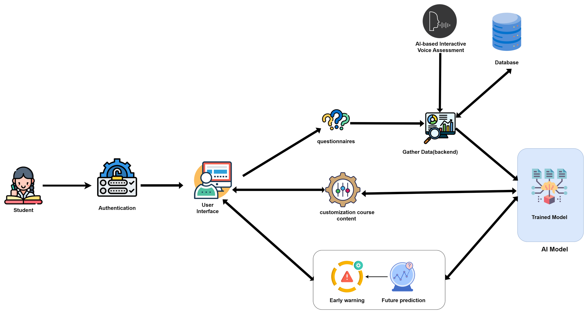
Sri Lanka Institute of Information Technology
System Diagram
24-25J-103
8/8/2024
IIT21194962 Niyangoda S A N S H

Slide 25
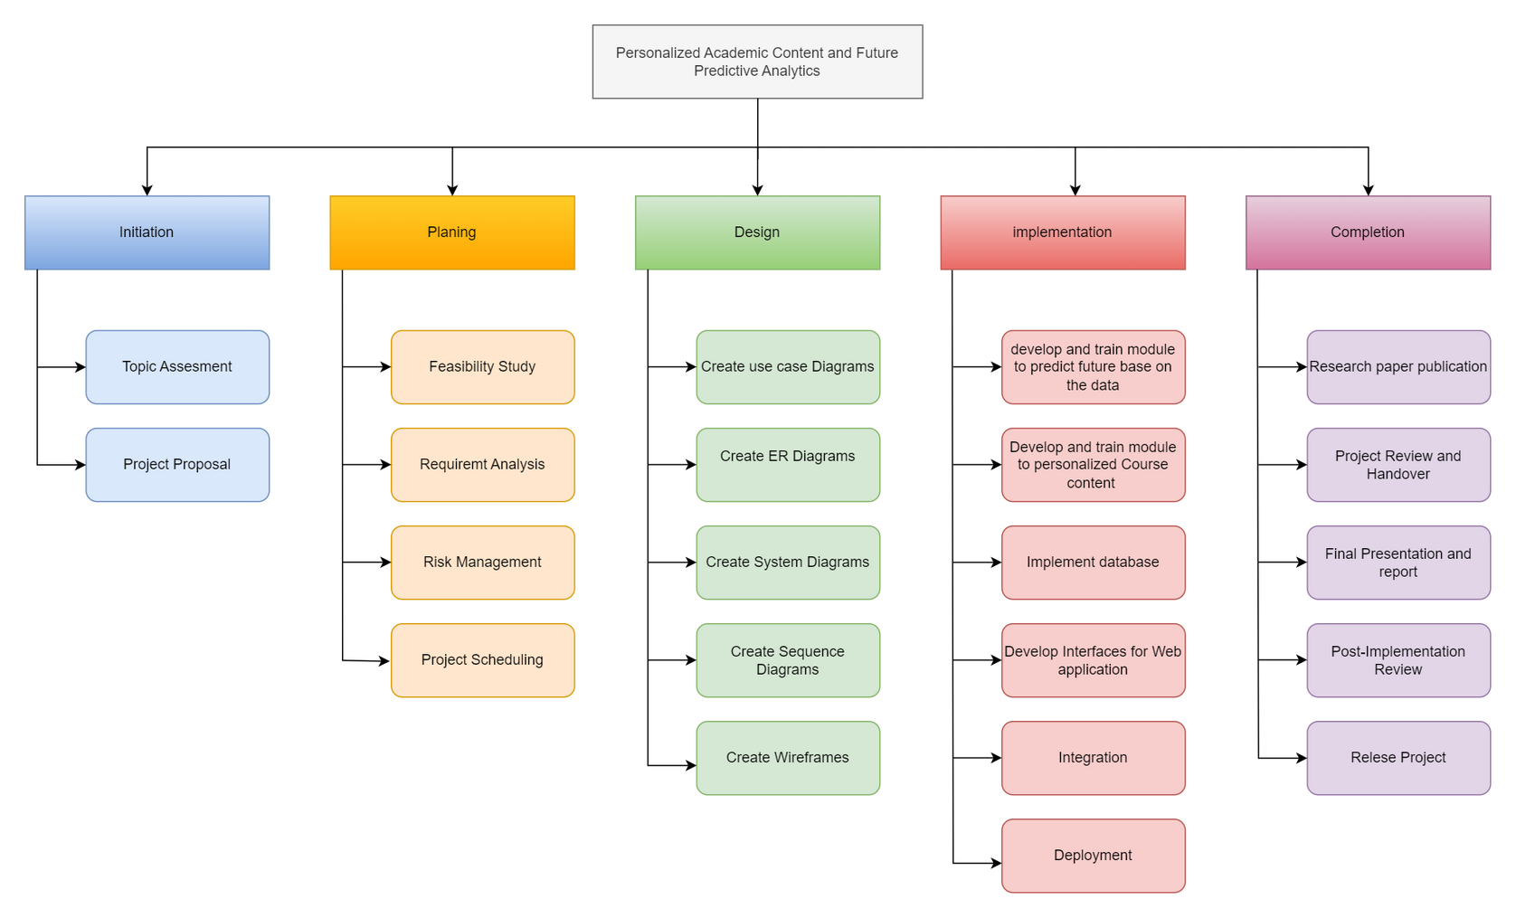
Sri Lanka Institute of Information Technology
WORK BREAKDOWN STRUCTURE
IT21194962 Niyangoda S A N S H
24-25J-103

Slide 26

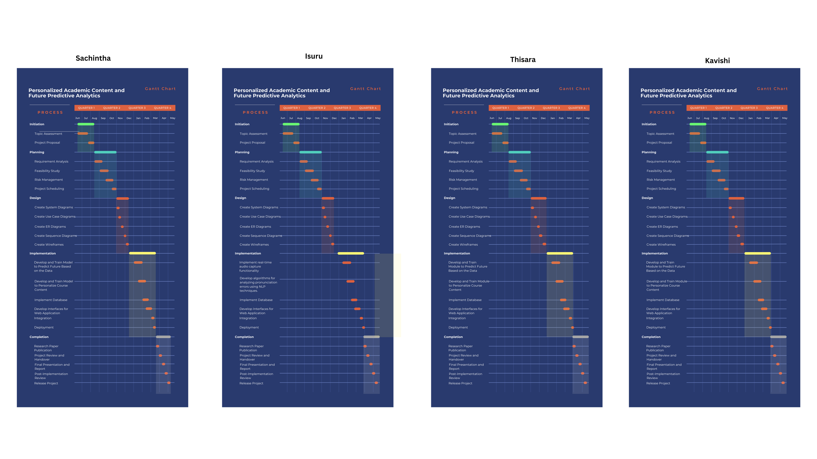
Sri Lanka Institute of Information Technology
GANNT CHART
24-25J-103
8/8/2024
IIT21194962 Niyangoda S A N S H

Slide 27
Sri Lanka Institute of Information Technology
REFERENCES
. Akçapınar, G., Hasnine, M. N., Majumdar, R., Flanagan, B., Ogata, H. (2019). Developing an earlywarning system for spotting at-risk students by using eBook interaction logs. Smart Learning Environments, 6, 1-15. https://doi.org/10.1186/s40561-019-0083-4
Adnan, M., Habib, A., Ashraf, J., Mussadiq, S., Raza, A. A., Abid, M., Bashir, M., Khan, S. U. (2021). Predicting at-risk students at different percentages of course length for early intervention using machine learning models. IEEE Access, 9, 7519-7539.
Nimy, E., Mosia, M., Chibaya, C. (2023). Identifying At-Risk Students for Early Intervention—A Probabilistic Machine Learning Approach. Applied Sciences, 13, 3869. https://doi.org/10.3390/app13063869
Er, E. (2012). Identifying at-risk students using machine learning techniques: A case study with IS 100. International Journal of Machine Learning and Computing, 2, 476. https://doi.org/10.7763/IJMLC.2012.V2.171
IT21194962 Niyangoda S A N S H
24-25J-103

Slide 28

Sri Lanka Institute of Information Technology
AI-BASED INTERACTIVE VOICE ASSESSMENT
24-25J-103
8/8/2024
IT20239220 Gamage M.I.S.

Slide 29
Sri Lanka Institute of Information Technology
BACKGROUND
Developing strong language skills including pronunciation and fluency is crucial for children aged 10-12, as this is a critical period for their cognitive and social development.
Traditional language learning methods, such as classroom instruction and rote memorization, often fail to engage students fully and address their individual needs.
To address these issues, we are going to use advanced AI-powered technologies to design an interactive and personalized learning environment.
These technologies will provide quick feedback, allowing for real-time practice and targeted assistance.
We aim to increase student engagement and empower them to develop their language abilities through the use of voice recognition and natural language processing, enabling improved communication for academic and social success.
24-25J-103
8/8/2024
IT20239220 Gamage M.I.S.

Slide 30
Sri Lanka Institute of Information Technology
REASEARCH GAP
Project 1 - Developing an AI-Assisted Low-Resource Spoken Language Learning App for Children.
Project 2 - The effectiveness of computer-assisted pronunciation training for foreign language learning by children
project 3 - Duolingo Language Learning Platform (existing System)
Study | Immediate Pronunciation Feedback | Pre-Assessment Pronunciation Assistance | Contextual Vocabulary Enhancement | Alignment with School Syllabus
Project 1
Project 2
Project 3
Proposed System
24-25J-103
8/8/2024
IT20239220 Gamage M.I.S.

Slide 31
Sri Lanka Institute of Information Technology
How can real-time feedback on pronunciation improve the speaking skills of children aged 10-12?
RESEARCH PROBLEMS
When children receive instant feedback, they can quickly identify and correct their mistakes
What impact does pre-assessment pronunciation assistance have on students' reading and speaking performance?
Pre-assessment pronunciation assistance allows students to listen to correct pronunciations before attempting to read aloud
What are the benefits of providing contextual vocabulary enhancement through an interactive word definition system?
Providing contextual vocabulary enhancement through an interactive word definition system helps students understand and retain new words more effectively
How does tracking individual performance over time with visual progress insights aid in identifying areas for improvement and enhancing learning outcomes?
Tracking individual performance over time and providing visual progress insights helps in identifying specific areas where students need improvement, allowing for targeted interventions.
24-25J-103
8/8/2024
IT20239220 Gamage M.I.S.

Slide 32
Sri Lanka Institute of Information Technology
SUB OBJECTIVES
01
Implement a functionality to Capture and record student pronunciations
02
Implement a functionality to convert student audio to text during reading sessions.
03
Identify pronunciation errors by comparing transcribed text with the original text.
04
Develop algorithms to provide instant feedback on pronunciation errors.
05
Implement functionality to convert text into audio for students to hear correct pronunciations.
06
Implement functionality to provide definitions and audio pronunciations of selected words.
24-25J-103
8/8/2024
IT20239220 Gamage M.I.S.

Slide 33



METHODOLOGY
TECHNOLOGIES
MERN Stack
Python
Tensorflow
WebRTC
Google Cloud
Git
Merriam-Webster API
24-25J-103
8/8/2024
IT20239220 Gamage M.I.S.

Slide 34
Sri Lanka Institute of Information Technology
SYSTEM, PERSONAL, AND SOFTWARE REQUIREMENT SPECIFICATION
Software Requirement
Personal Requirement
Functional Requirement
Non-Functional Requirement
MERN Stack
Tensorflow
Python
WebRTC
Merriam-Webster API
School teacher
School children
User Authentication
Data Collection
Reading Material Presentation
Speech-to-Text Conversion
Pronunciation Feedback
Pre-Assessment Pronunciation Assistance
Contextual Vocabulary Enhancement
Progress Tracking
Performance
Reliability and Availability
Security
The system must be able to handle a large number of requests
24-25J-103
8/8/2024
IT20239220 Gamage M.I.S.

Slide 35
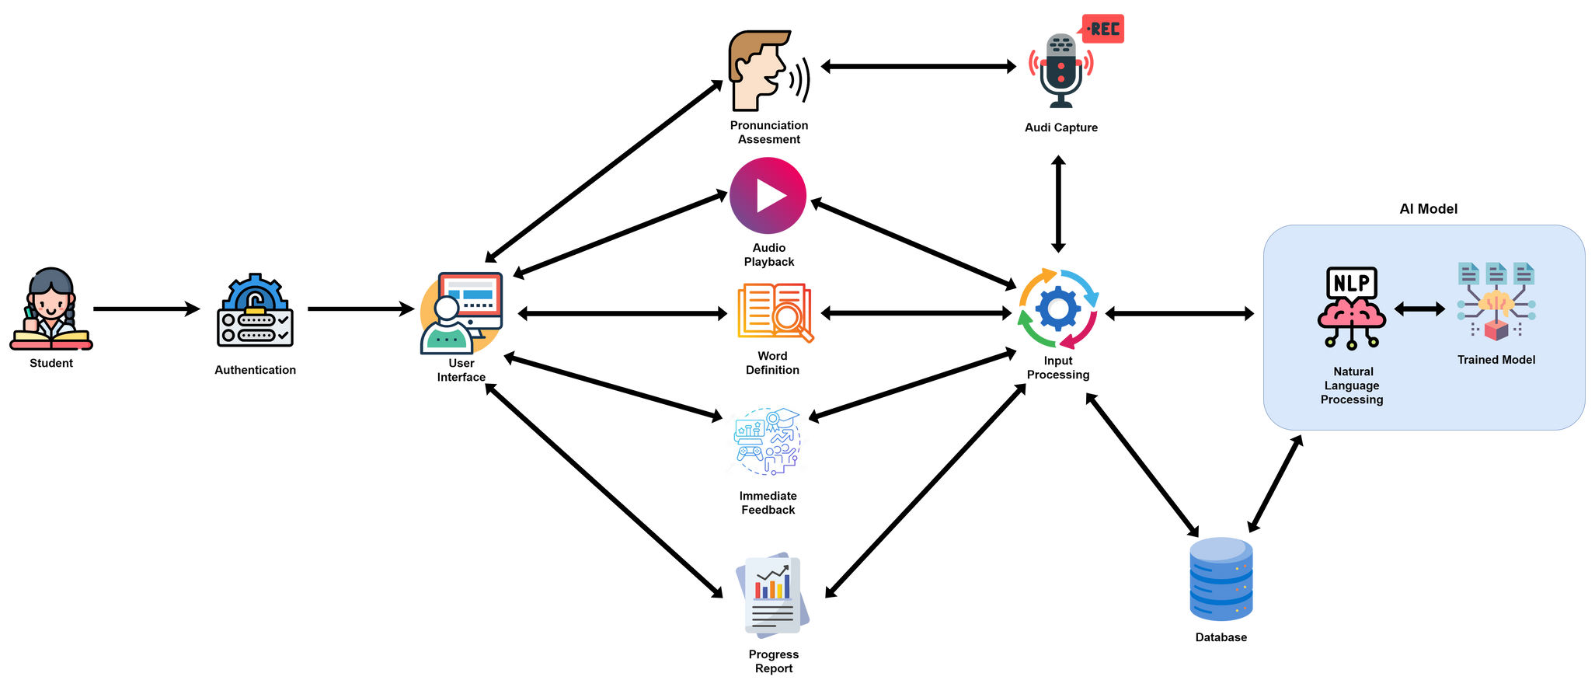
Sri Lanka Institute of Information Technology
System Diagram
24-25J-103
8/8/2024
IT20239220 Gamage M.I.S.

Slide 36
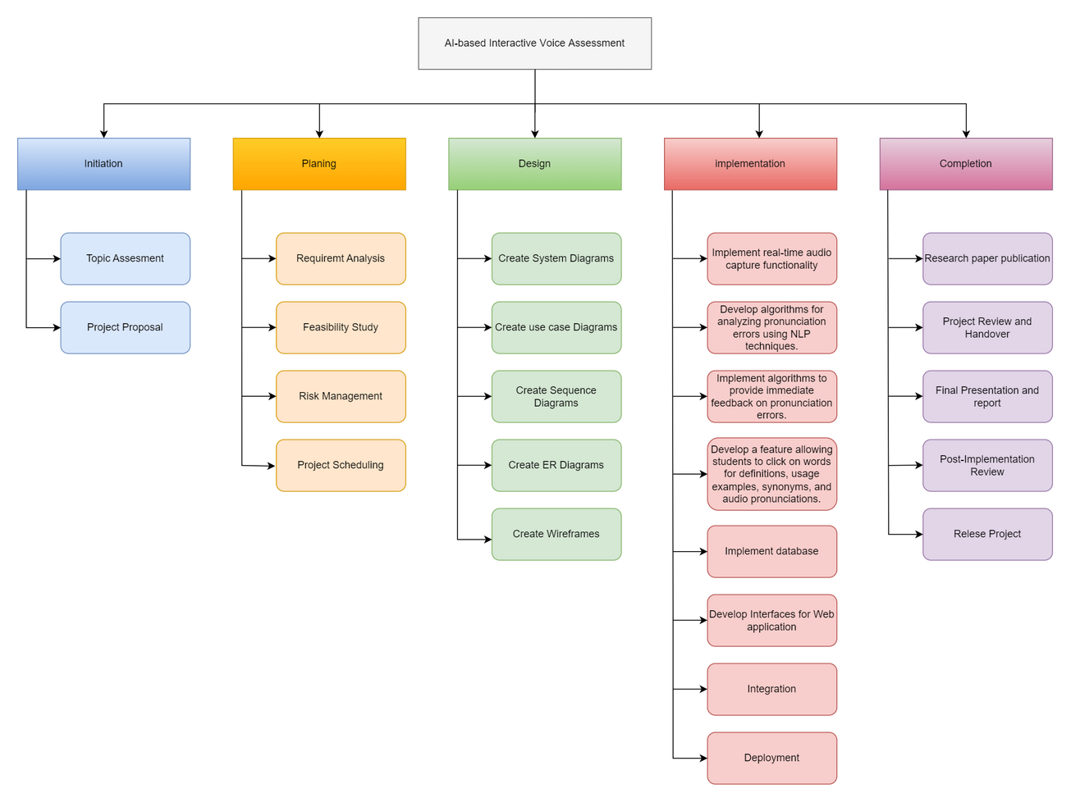
Sri Lanka Institute of Information Technology
WORK BREAKDOWN STRUCTURE
24-25J-103
8/8/2024
IT20239220 Gamage M.I.S.

Slide 37

Sri Lanka Institute of Information Technology
GANNT CHART
24-25J-103
8/8/2024
IT20239220 Gamage M.I.S.

Slide 38
Sri Lanka Institute of Information Technology
REFERENCES
. J. Xu, H. Wang, and Z. Li, "Developing an AI-Assisted Low-Resource Spoken Language Learning App for Children," Proceedings of the 2023 Conference on Human Factors in Computing Systems, 2023. https://ieeexplore.ieee.org/document/10214276
The effectiveness of computer-assisted pronunciation training for foreign language learning by children.
https://www.tandfonline.com/doi/abs/10.1080/09588220802447651
Duolingo, "Duolingo Language Learning Platform," 2024.
https://www.duolingo.com/
24-25J-103
8/8/2024
IT20239220 Gamage M.I.S.

Slide 39

Sri Lanka Institute of Information Technology
AI - STUDENT ASSISTENT
24-25J-103
8/8/2024
IT21196560 Dewinda A G T

Slide 40
Sri Lanka Institute of Information Technology
BACKGROUND
Effective language development is crucial for children aged 10-12, a key period for cognitive and social growth. Traditional methods often lack engagement and personalization.
To address this, we are implementing an AI-powered student assistant in our LMS. This assistant uses advanced NLP to provide relevant, personalized advice and step-by-step guidance on English topics. The child-friendly interface enhances accessibility and engagement.
Our goal is to create an interactive, effective learning environment that supports language skills and boosts student interest.
24-25J-103
8/8/2024
IT21196560 Dewinda A G T

Slide 41


Sri Lanka Institute of Information Technology
REASEARCH GAP
Project 1 - Tsankov, P., Makarov, K., Al-Rfou, R., & Sutskever, I. (2020). Deep learning for education: Applications of deep learning models in understanding and generating natural language in educational settings.
Project 2 - Canvas (existing System
project 3 - Moodle (existing System)
Study | Course Assistance | FAQs for English content | Personalized Learning Adviso | Quiz Guidance
Project 1
Project 2
Project 3
Proposed System
24-25J-103
8/8/2024
IT21196560 Dewinda A G T

Slide 42
Sri Lanka Institute of Information Technology
How do students receive additional assistance for learning English?
RESEARCH PROBLEMS
How will students access course materials and navigate the system flow?
What strategies can be employed to offer advice that enhances student motivation?
How can support be provided for students' quizzes and questions?
24-25J-103
8/8/2024
IT21196560 Dewinda A G T

Slide 43
Sri Lanka Institute of Information Technology
SUB OBJECTIVES
01
Develop an AI that understands and responds to children’s educational inquiries
02
Ensure the assistant delivers contextually relevant responses.
03
Create a child-friendly interface to enhance learning accessibility and interest
04
Create to monitor whether the student student is stuck in a question quiz and give a hint or guides to do it
05
Create a component to provide advises to motivate student and overcome challeges
24-25J-103
8/8/2024
IT21196560 Dewinda A G T

Slide 44

Sri Lanka Institute of Information Technology
METHODOLOGY
SYSTEM, PERSONAL, AND SOFTWARE REQUIREMENT SPECIFICATION
Software Requirement
Personal Requirement
Functional Requirement
Non-Functional Requirement
Tensorflow
Python
MERN
NLTK
School teacher
School children
Natural Language Understanding
Relevance and Knowledge Delivery
Study and Personalized Advice
Learning Enhancement
Child-Friendly Design
Performance
Reliability and Availability
Accessibility
24-25J-103
8/8/2024
IT21196560 Dewinda A G T

Slide 45
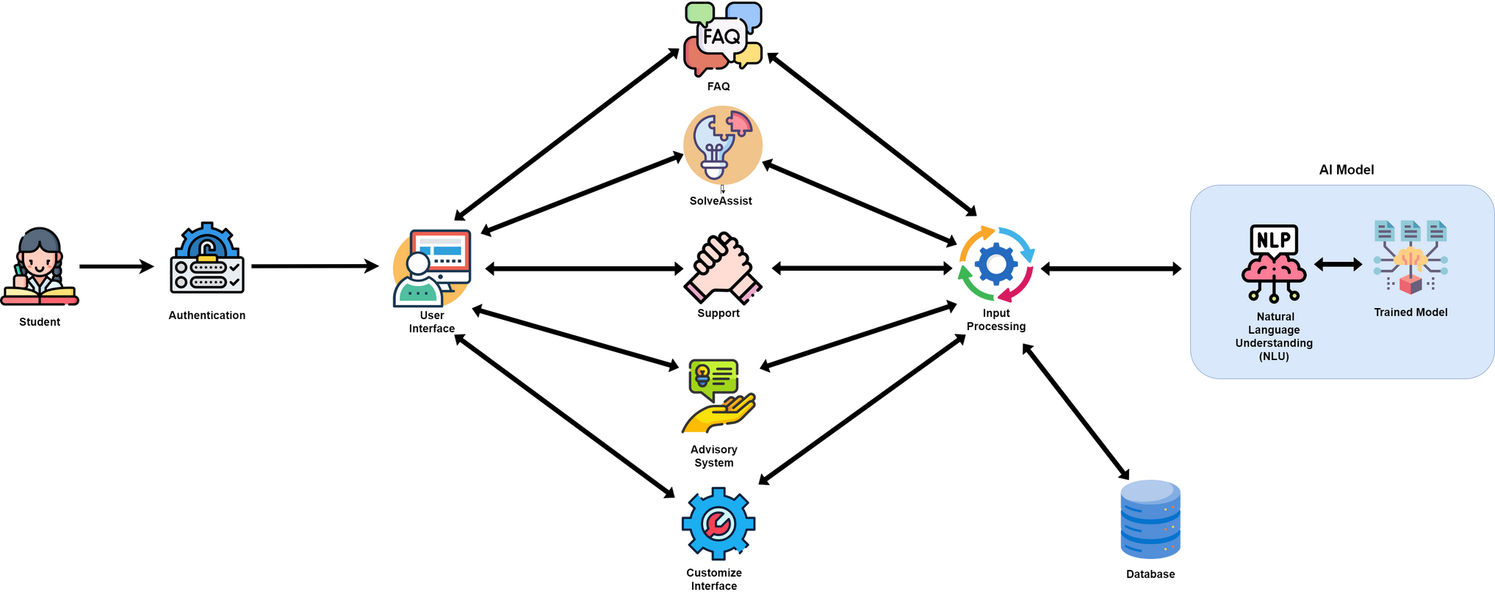
Sri Lanka Institute of Information Technology
System Diagram
24-25J-103
8/8/2024
IT21196560 Dewinda A G T

Slide 46

Sri Lanka Institute of Information Technology
WORK BREAKDOWN STRUCTURE
24-25J-103
8/8/2024
IT21196560 Dewinda A G T

Slide 47
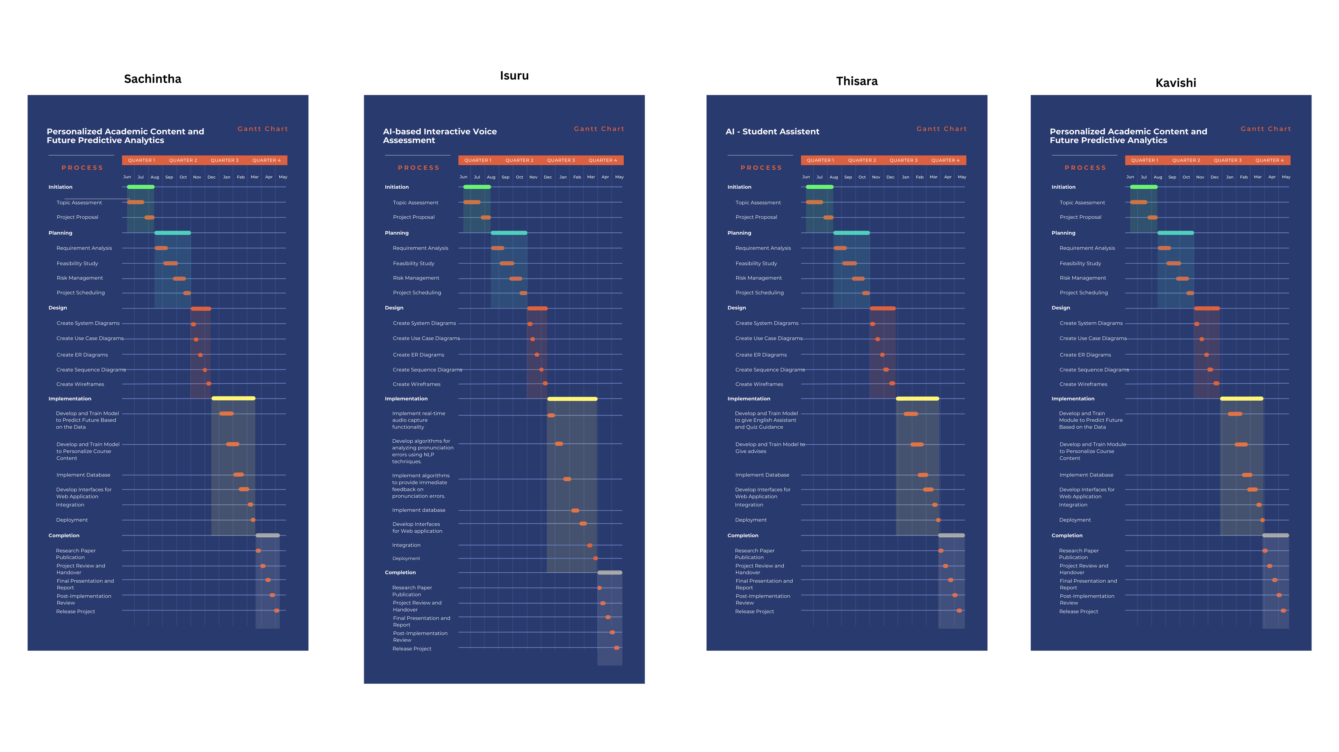
Sri Lanka Institute of Information Technology
GANNT CHART
24-25J-103
8/8/2024
IT21196560 Dewinda A G T

Slide 48
Sri Lanka Institute of Information Technology
REFERENCES
. Tsankov, P., Makarov, K., Al-Rfou, R., & Sutskever, I. (2020). Deep learning for education: Applications of deep learning models in understanding and generating natural language in educational settings
Zhang, Y., Chen, X., & Zhang, M. (2021). A survey on natural language processing for education: Overview and applications in educational tools.
Manning, C. D., Raghavan, P., & Schütze, H. (2008). Relevance ranking in information retrieval: A critical survey of techniques and applications.
Kopp, B., Isotani, S., & D’Mello, S. (2017). Interactive learning environments: Design, evaluation, and the effectiveness of step-by-step guidance.
24-25J-103
8/8/2024
IT21196560 Dewinda A G T

Slide 49
Sri Lanka Institute of Information Technology
THANK YOU

